Slide 1
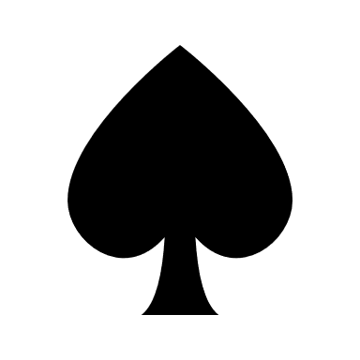
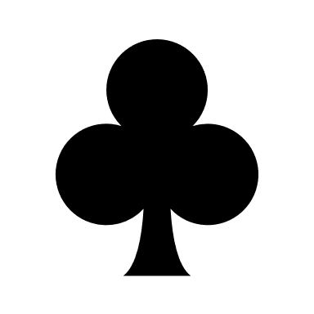
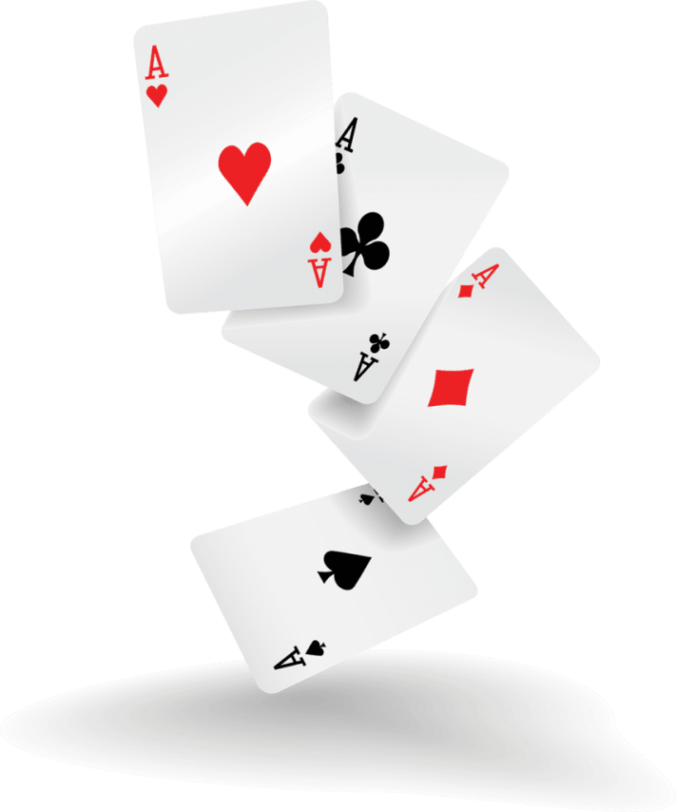
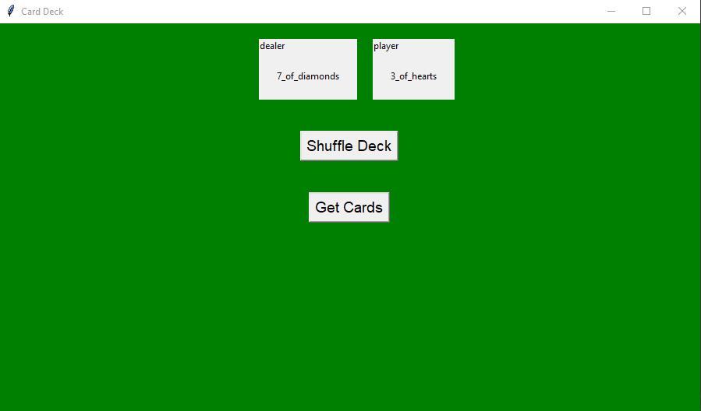
WAR – The Card Game
By Henry Casnocha
Everyone needs a little game to distract them every now and then so I produced the idea to make the card game War into a fun little desktop GUI that one can play during some down time. it’s a very simple game in which who ever has the highest ranked card takes the other players card. Each game will be played until a full 52 card deck is played and who ever has the most cards at the end is the winner of the game.
This is a screen shot of what the GUI will look like.

